Slide 1

Access control and Authentication techniques and models
G Naresh
17BCS018
Under the guidance of : Dr Uma S

Slide 2
Contents
Introduction
Brief about Authorization
Access control mechanisms/models
Case study
Conclusion

Slide 3
Introduction
Information is a critical resource in today’s enterprise, whether it is industrial, commercial, educational etc. As the organizations increase their adoption of database systems as the key data management technology for day-to-day operations and decision making, the security of data becomes crucial. Any database security should provide controlled, protected access to the contents of database as well as preserve the integrity, consistency and overall quality of the data.
Database security encompasses three constructs: confidentiality, integrity, and availability.

Slide 4
Authorization
All access control mechanisms are based on some authorization model, which deﬁnes how a database management system must implement access control. It is generally composed by:
(i) access granularity indication : Access granularity deﬁnes the storage unit to control data access – e.g., at the tuple, tables or databases levels
(ii) structures to represent the authorization (formal semantics of representation) : The most common authorization structure is represented by the triple <s, o, m>, where: s is the subject who receives the authorization, o the object which is authorized and m the access mode.

Slide 5
(iii) a set of policies to manage and to grant authorizations : The set of policies to manage authorizations are rules that deﬁne: who will grant and revoke permissions (e.g., owner, administrator, any user), operations authorized (e.g., read, write), and how these will be executed. Policies also deﬁne factors such as negative authorizations and authorization derivation.
(iv) algorithms to analyze access requests based on the existing authorizations : Finally, in order to have a complete authorization model, one must also deﬁne mechanisms or algorithms to validate an access request based on the stored authorizations.

Slide 6
Access control mechanisms/models
Current research eﬀorts on access control can be classiﬁed in three main directions:
Discretionary Access Control (DAC)
Mandatory Access Control (MAC) and the combination of both,
the Role Based Access Control (RBAC).
Eﬀorts normally are deﬁned in terms of the <s, o, m> structure, and these are most commonly used in GIS and some databases.

Slide 7
DAC
In DAC, restrictions on access to database system is based on the identity of subjects and/or groups to which they belong to and authorization rules.
The owner of the resource has the complete control over who can have access to a specific resource.
DAC is discretionary in the sense that it allows subjects to grant database access control to other subjects. Due to the flexibility of granting permission, discretionary access control model is adopted by many commercial DBMSs i.e. Oracle9i, MySQL etc.
The DAC has the flexibility of granting access but this benefit results in the drawback of illegal access to confidential information due to inappropriate passing of access controls.

Slide 8
MAC
MAC is a mean of restricting access to objects based on sensitivity of the information contained in the objects and the formal authorization of subjects to access information of such sensitivity.
MAC stands for Mandatory Access Control. In this method, access is determined by the system, not by the owner. Systems that contain highly sensitive data such as government or military based systems use this access control type.
In this control, all users (subjects) and resources should have a label assigned to them. It is a security label and specifies the level of trust. To access the resource, the user must have equal or higher sensitivity level than the level of the required resource. For example, if the user requires accessing a secret file, he should have a secret clearance or a higher clearance to access the resource.

Slide 9
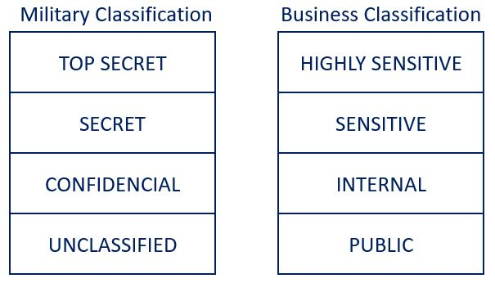

Slide 10
RBAC
In RBAC, policies are described in terms of users, subjects, roles, role hierarchies, operations, relationships, and constraints.
The users are granted membership into roles based on their competencies and responsibilities.
The users must be active in a role and authorized as a member of the role by a security administrator for performing operations. The main theme of RBAC is that it provides the capability to administrators to place constraints on role authorization, role activation, and operation execution.
RBAC makes the management of permissions easier, supports for principle of least privilege, separation of duties etc.

Slide 11
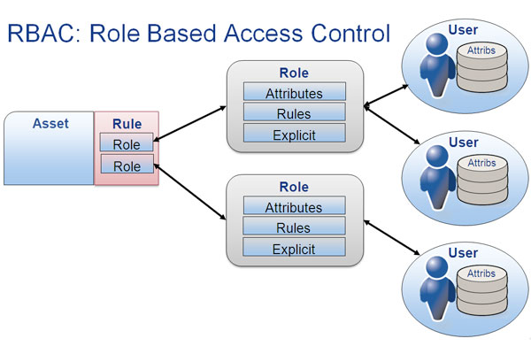

Slide 12
OrBAC
Organization Based Access Control (OrBAC) is first presented in 2003. The aim of this model is to solve some problems in the previous AC models (DAC, MAC and RBAC), to find a more abstract control policy. It is designed to address the subject, object and action, in such a way that the policy determines what subject(s) has some action(s) to access some object(s).
Each organization (clinic, banks, hospitals…) is comprised of a structured group of subjects having certain roles, or entities. This model exceeds the concept of only granting permissions to subjects, it also addresses the concept of prohibitions, obligations and recommendations. A role may have a permission, prohibition or obligation to do some activity on some view given an associated context.
The context is presented in OrBAC to express dynamic rules for relations between entities, for example, Permission, Prohibition, Isprohibited, Recommendation, Ispermitted, Isobligatory, Isrecommended, Obligation. The OrBAC has an advantage in eliminating conflicts between security rules. It also has some vulnerabilities to some kinds of attacks, e.g. covert channels.

Slide 13
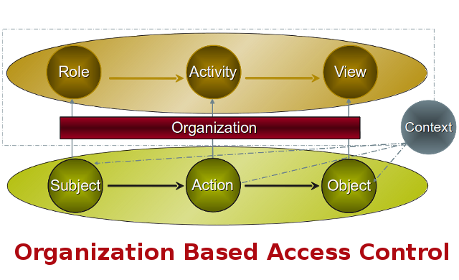

Slide 14
TRBAC
TRBAC is an extension of RBAC which supports temporal constraints on the enabling/disabling of roles.
Such constraints are expressed by means of role triggers can also be used to constrain the set of roles that a particular user can activate at a given time instant.
The firing of a trigger may cause a role to be enabled/disabled either immediately, or after an explicit specified amount of time.

Slide 15
RDBAC
Previously discussed techniques face weakness in granting access control at more fine-grained level i.e. access control at certain portions of database table.
RDBAC is a model in which a database privilege is expressed as a database query itself, rather than as a static privilege contained in an access control matrix.
One of the main advantages of RDBAC is that it aids in improving the expressiveness of access control policies.
These models provide a handsome flexibility in some cases such as users are allowed to define access privileges for their own tables, without requiring super user privileges.

Slide 16
CASE STUDY:IMPLEMENTATION OF RDBAC FOR STUDENTS RESULTS INFORMATION SYSTEM
In this case study we discuss the privacy policies of students result information system. This system allows the students to view their results as well as facilitates the instructors to upload the results and also the Exam Branch coordinators to manage the results. The administrators have access of the whole system for monitoring and management.

Slide 17
POLICIES
General purpose
User can only login to the system if his/her status is “Active”.
Users can view their own personal information only.
Users can only update their own personal and contact information.
Deletion of any record from the database will not actually delete the record physically from database rather its status would be marked as Inactive.

Slide 18
Policies for Instructor
The instructor can only upload the result information of the students that are enrolled with his/her course.
The instructor can only view the results data and the contact information of the students that are enrolled with the course taught by the same instructor.
An instructor can only update, delete the result data of the students registered with his/her own course before the results are marked as finalized by the instructor.
Once the students’ results are finalized by the instructor, the instructor will not be able to change the results later.
The instructor can also change the status of the student’s results information like “Result Late” to “Announced” for the students enrolled with his/her course only.
Only the instructor and the Administrator can view the contact information of the exam coordinator.
The instructor can update his/her own contact information
The instructor can only send the result information of a student via email on the student request, provided the student email is there and it is correct.

Slide 19
Policies for Students
A student can only view the results of his/her own subject.
Student can view the contact information of the instructor of the course with which he/she is enrolled.
Student would be capable of updating his/her own contact information
Student can only contact to the instructors of the subjects they have taken regarding any results related issues.
Students can view the detailed results of other students before the final term exams. These details include the marks obtained in midterm, assignments, quizzes, projects etc.

Slide 20
Policies for Exam Coordinator
Exam coordinator can only view the results of all the students that are currently enrolled with any subject.
Exam coordinator can view the contact information of the instructor associated with a course for any type of grading issue.
The exam coordinator can contact to the administrator in case of any issue in the system.
Only the exam coordinator can change the student results after it is marked as finalized by the instructor, keeping in mind the actions are recorded and will be audited later.

Slide 21
Policies for Parent/Guardian
Parents/Guardians can only view the final result and grades of their own children, published at the website.
Parents/Guardians can only view the result information of their own child, published at the website.
Parent/Guardian can also view the contact information of the instructors having the courses with which their children are enrolled.

Slide 22
Policies for Administrator
The administrator can view all the data from any table
The administrator and the instructor can only view the contact information of the exam coordinator.
Only the administrator can change the status of the users from Active to Inactive and vice versa.
Only the administrator can view the change logs generated during various actions performed in the system.
Only the administrator can add a new user in the system.
The administrator can’t change the contact information of any other user in the system.
The administrator can only view the students’ results but can’t change the students’ results.

Slide 23
Policies implementation in RDBAC
Basic Status Policy (Active)
Basic Access Policy (Has_Access)
Contact Policy
View Result Policy
Insert Result Policy
Update Result Policy
Delete Result Policy
Policies that are defined using the Transaction datalog can be expressed in standard query language (SQL) that is understandable for the DBMSs.

Slide 24
Similarly if we wanted to implement TRDBAC then
The following policies need to be implemented using the time constraints:
If the Exam Coordinator is not available due to certain reason and a necessary change in the results is required then we may allow the instructor to update the results for a certain time period.
For instance, the instructor is allowed to update the results from June 28, 2010 9:00 AM to June 30, 2010 5:00 PM.

Slide 25
Another scenario where we need to implement the TRDBAC is to allow the students to view the results for some specific time period then the result will go offline. For instance, we say that the students are allowed to view the results from July 1st 2010 12 AM to July 5th 2010 5:00 PM.

Slide 26
Conclusion
RDBAC is strong enough to implement the access control policies at the database level instead of implementing at application level. In some scenarios we are not only interested to implement the policies at database level but also interested to have some time constraints for the subjects. For that purpose we introduced TRDBAC which is the extension of RDBAC and proved a good temporal model that allows us to have some time constraints in our policies.

Slide 27
THANK YOU

